Slide 1


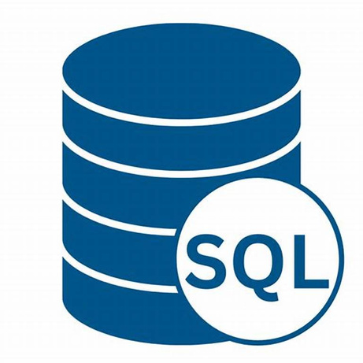
DAHEL TECHIES
SQL
By Modinat Ganiyu

Slide 2
DATABASES (DB)
A database is an organized collection of structured data that is stored and managed on a computer system. It serves as a reliable and efficient way to store, retrieve, and manage vast amounts of information.
Databases can be stored in different ways
•On paper
•In your mind
•On a computer
•This powerpoint
•Comments Section

Slide 3
ILLUSTRATION
A database is like your organized library for storing and managing information. It's a digital system that helps you store, organize, and retrieve data efficiently.
Instead of physical books, a database uses tables to hold information. Each table is like a category or a specific type of information you want to store, such as a table for storing customer details or a table for tracking sales.

Slide 4
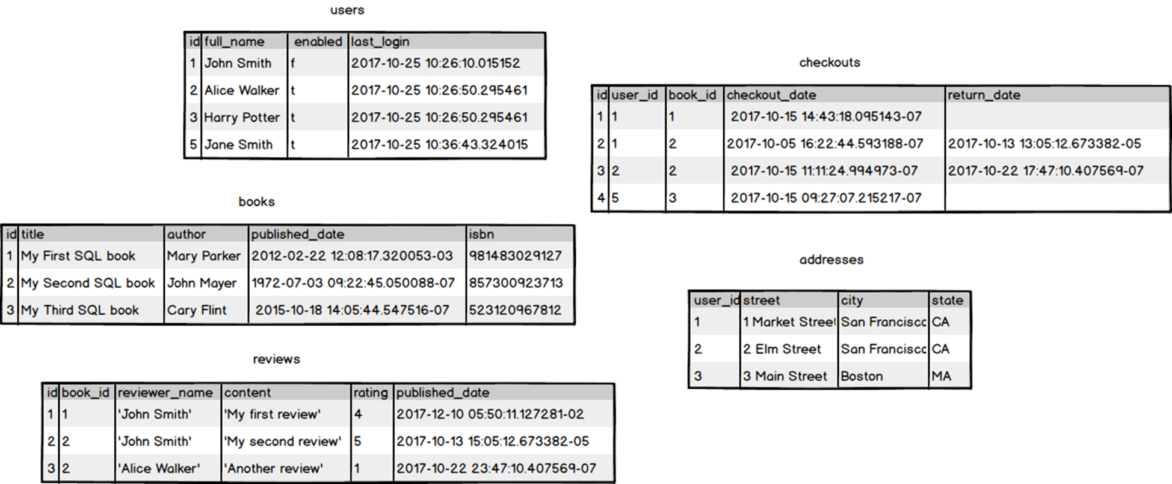
DATABASE

Slide 5

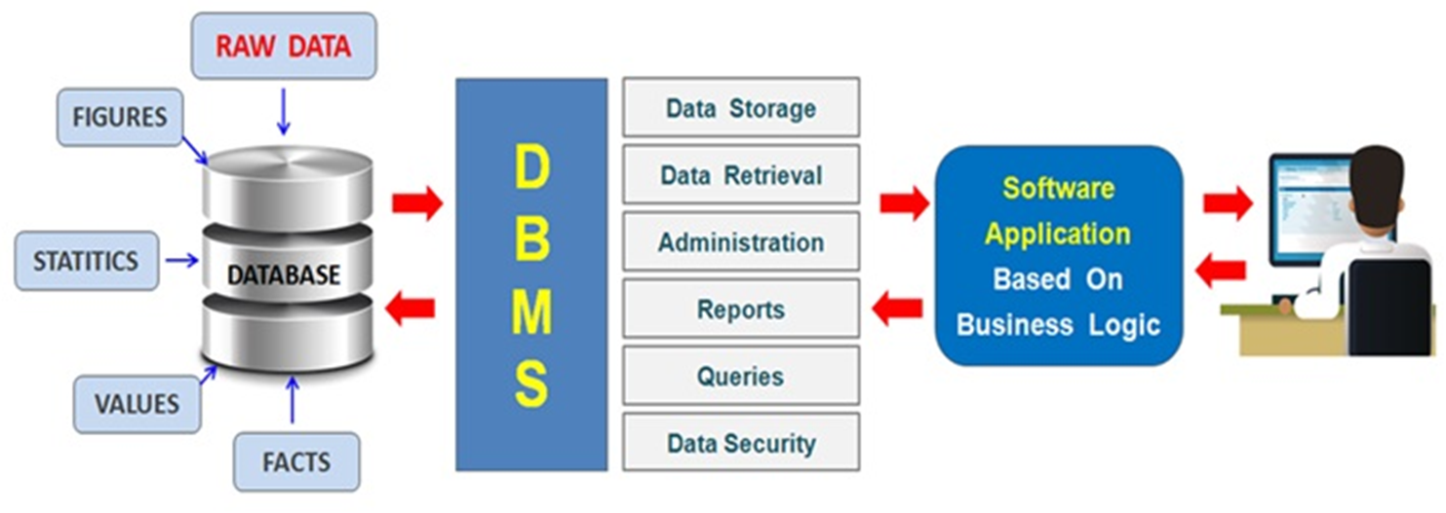
Database Management System (DBMS)
A Database Management System (DBMS) is a software system designed to store, retrieve, manage, and manipulate data in databases. It serves as an intermediary between the user and the database
The DBMS provides ways for the data to be modified or extracted by users or other programs.

Slide 6
Types of Database Management System (DBMS)
Here's an overview of the primary types of databases:
Relational Databases (RDBMS)
•Description: Stores data in tables with rows and columns, where each row represents a record and each column represents a data field. This model uses a structured query language (SQL) for data manipulation and queries.
•Use Cases: Widely used in banking, human resources, and anywhere else structured data is essential.
•Examples: MySQL, PostgreSQL, Oracle Database, Microsoft SQL Server.
Non-Relational Databases
•Description: A broad category that includes any database that doesn't use the tabular schema of rows and columns found in relational databases. NoSQL databases are designed to handle large volumes of unstructured or semi-structured data.
They are categorized into four main types:
•Document Databases: Store data in documents similar to JSON objects.
•Key-Value Stores: Store data as key-value pairs.
•Wide-Column Stores: Store data in tables, rows, and dynamic columns.
•Graph Databases: Use graph structures with nodes, edges, and properties to represent and store data.
•Use Cases: Real-time web applications, big data processing, and applications requiring flexible schemas.
•Examples: MongoDB (Document), Redis (Key-Value), Cassandra (Wide-Column), Neo4j (Graph).

Slide 7
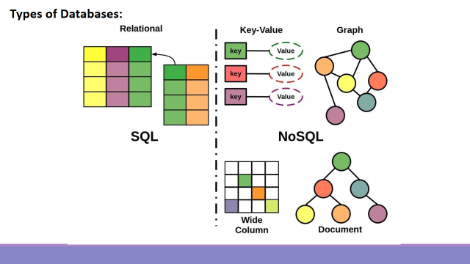

Slide 8
What is SQL?
SQL stands for Structured Query Language. It's a standardized programming language used for managing and manipulating relational databases.
SQL enables you to perform tasks such as querying data, updating data, inserting new data, and deleting data from a database. Additionally, it allows for the creation and modification of database schema (structure) and control over data access.
Essentially, if you need to interact with data stored in a relational database, SQL is the tool you'll likely use.
SQL implementations are designed to allow users to create, read, update and delete data within a database.

Slide 9
Database Systems
There are various database management systems (DBMS) that implement SQL, each with its own specific syntax and features. Here are some popular SQL implementations:
•MySQL
•PostgreSQL
•SQLite
•Oracle Database
•Microsoft SQL Server

Slide 10
Sublanguages in SQL
In SQL, the commands are categorized into different sublanguages based on their functionality. Here are the sublanguages in SQL
Data Query Language (DQL)
Data Definition Language (DDL)
Data Manipulation Language (DML)
Data Control Language (DCL)
Transactional Control Commands
Each sublanguage serves a different purpose within the SQL framework, and together they provide comprehensive capabilities for interacting with and managing a database.

Slide 11
Sublanguages in SQL
Data Query Language (DQL)
SQL allows users to query the database to retrieve data. The purpose of this language is to retrieve data from the database. Common Command is SELECT
Data Definition Language (DDL)
SQL defines a database through commands that create, alter and drop tables and other database structures. This focuses on the structure rather than the manipulation of the data itself.
Data Manipulation Language (DML)
SQL is used to insert, update, delete, and manipulate data within existing structures.
Data Control Language (DCL)
With SQL, it's possible to control access to the data and permissions within the database using commands like GRANT and REVOKE. This role situates SQL as a control language, managing security and access.
Transactional Control Commands
SQL includes commands for managing transactions such as COMMIT, ROLLBACK, and SAVEPOINT to ensure data integrity.

Slide 12
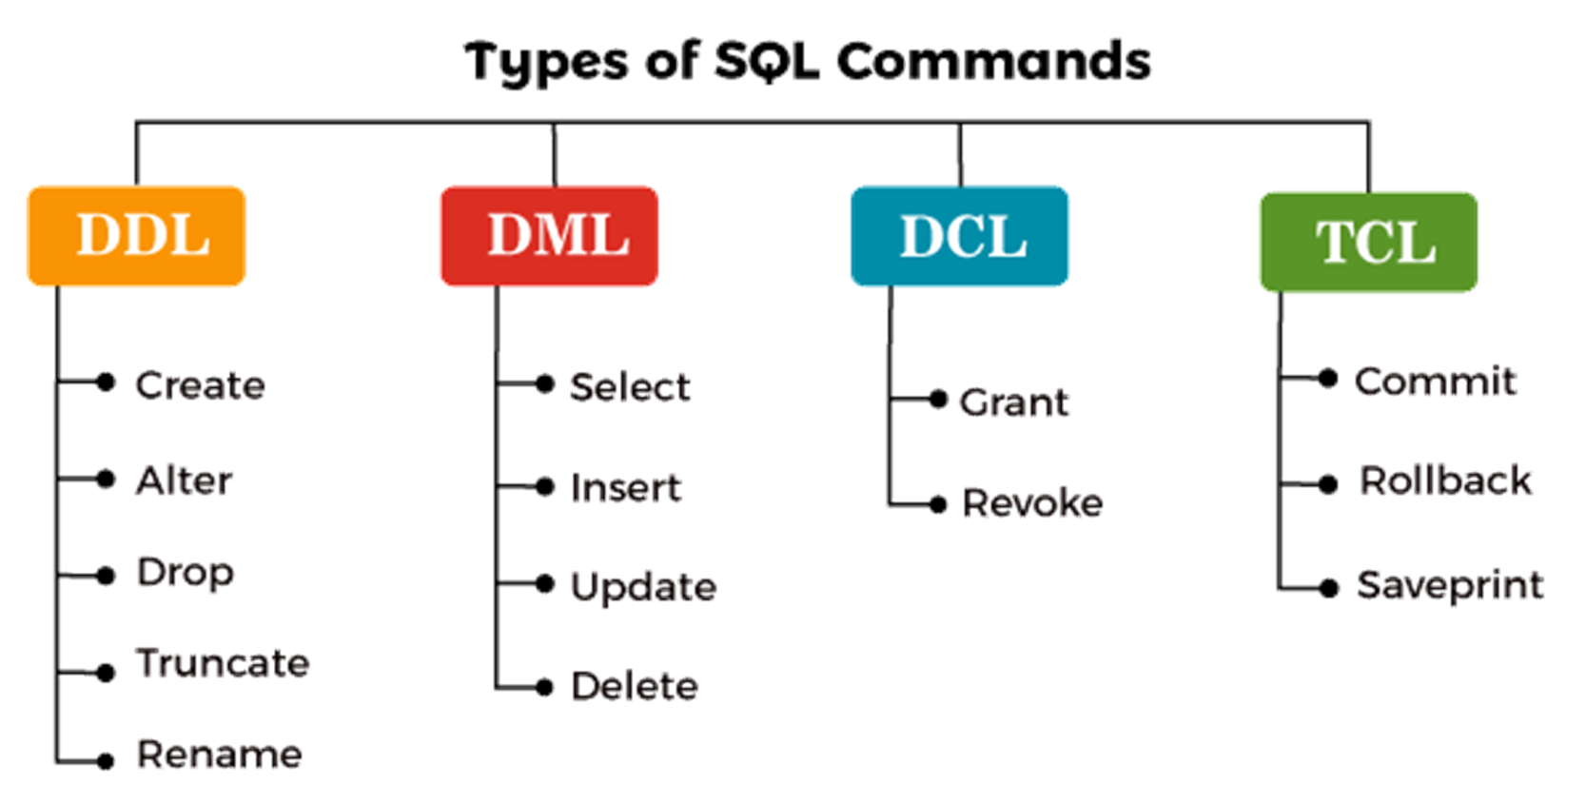

Slide 13
Microsoft SQL Server
link - https://www.microsoft.com/en-us/sql-server/sql-server-downloads

Slide 14


